Slide 1
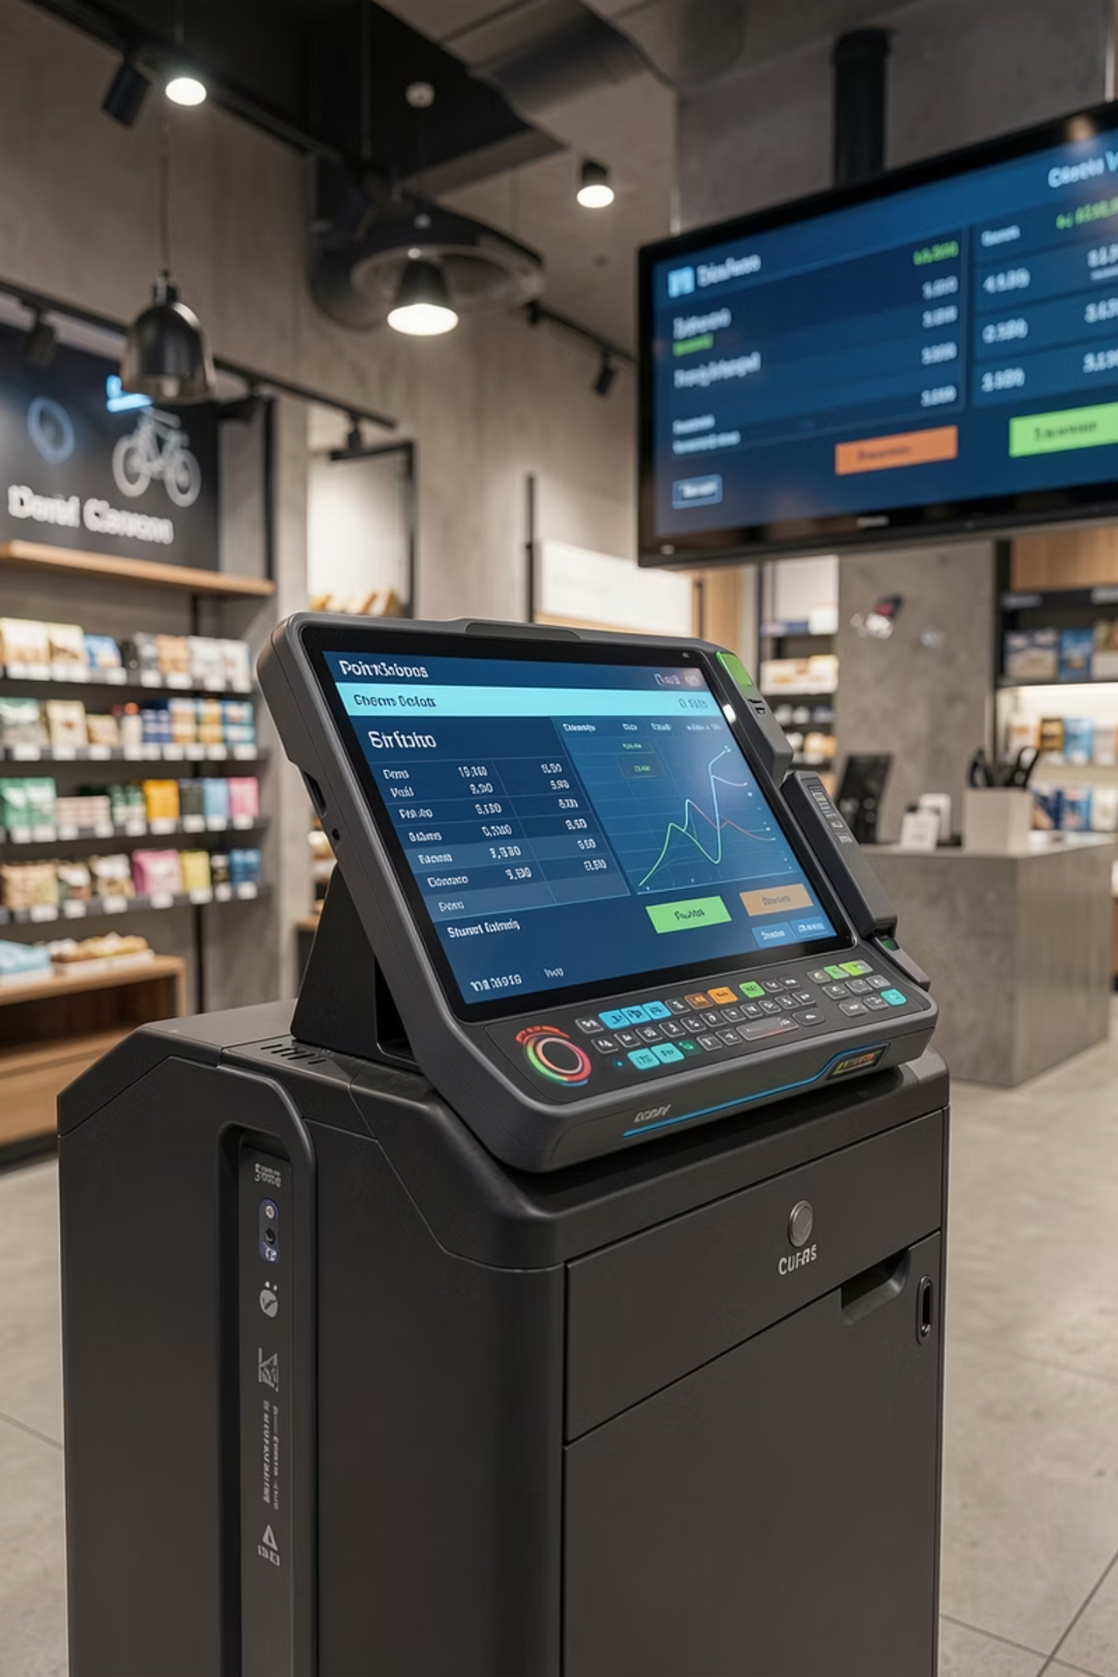
Departmental Store Billing System
Object-Oriented Programming — Final Project Presentation
Presented By: Tahir Noor · Reg. No. 2025-CYS-170
Department of Computer Engineering · UET Lahore ·

Slide 2

PROJECT OVERVIEW
Introduction
This project presents a structured, object-oriented billing solution for departmental stores. Manual billing processes are error-prone and inefficient — this system automates transactions, customer management, and receipt generation using core OOP principles.
Problem
Solution
Manual billing introduces calculation errors, delays, and poor record-keeping in retail operations.
A modular, OOP-based billing system with role-based access and automated calculations.
Significance
Demonstrates practical application of OOP in real-world software engineering.

Slide 3



PROJECT GOALS
Project Objectives
Develop a Billing Management Solution
Design a reliable system for processing customer transactions and generating receipts.
Apply OOP Principles
Implement encapsulation, abstraction, and class-based design in a practical context.
Efficient Record Management
Maintain accurate customer and item records with structured data handling.
Improve Modularity
Ensure the system is maintainable, extensible, and well-organized.

Slide 4
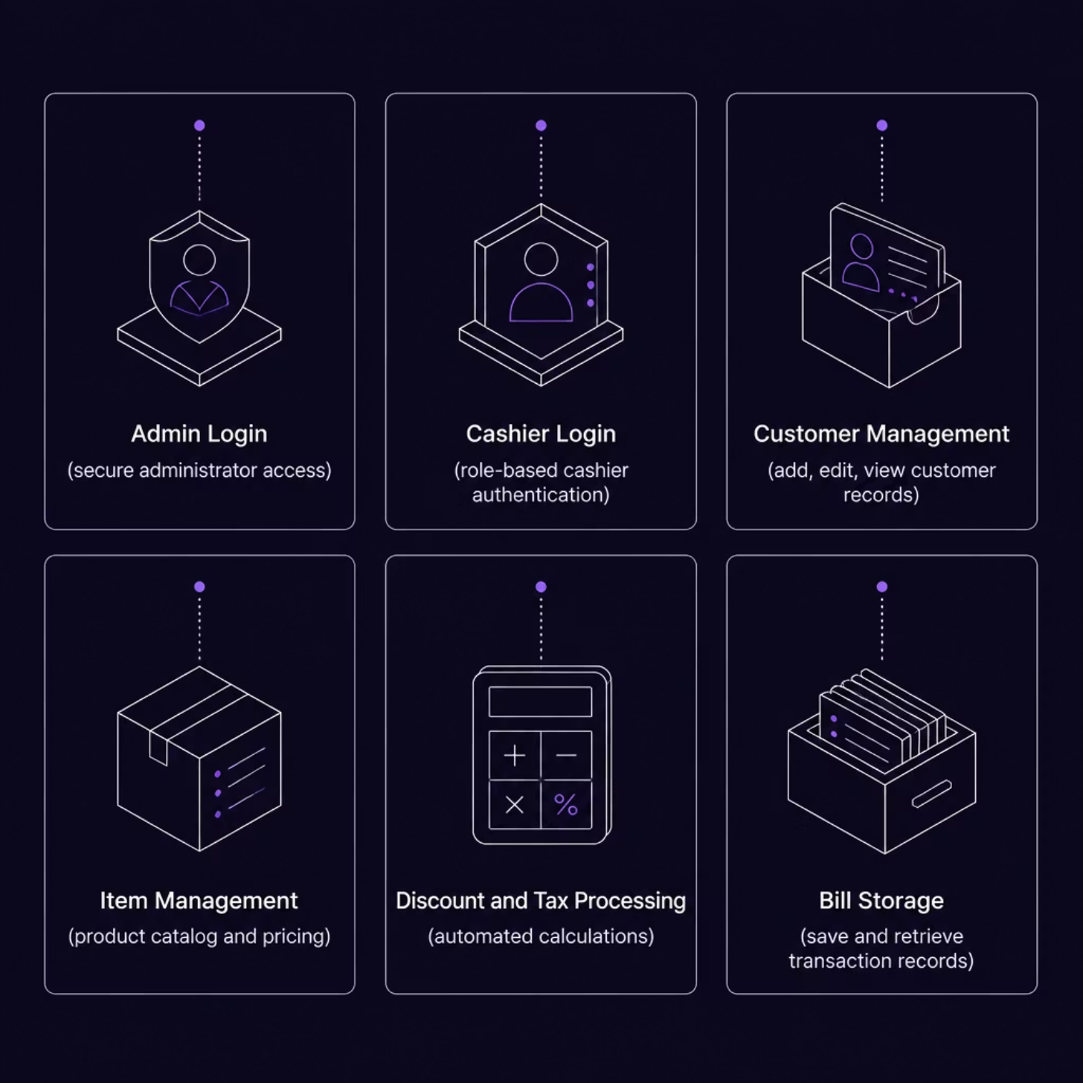
FEATURES & COVERAGE
Scope and Key Features
System Scope
Designed for small and medium departmental stores, covering customer billing, product management, and automated receipt generation.
Key Features
Admin & Cashier Login (Role-Based Access)
Customer & Item Management
Discount & Tax Processing
Multiple Payment Methods
Bill Storage & Retrieval

Slide 5
CORE CAPABILITIES
System Functionalities
The system defines two distinct user roles with dedicated permissions, ensuring operational security and task separation.
Feature
Admin
Cashier
Authentication
Secure admin login with full access
Restricted cashier login
Item Pricing
Update and manage item prices
Read-only access
Inventory
Update stock quantities
View availability only
Billing
Oversee all billing operations
Add items, apply discounts & taxes
Payments
Monitor transactions
Process payments, generate receipts

Slide 6

TRANSACTION FLOW
Billing Process and Receipt Generation
Customer Info
Subtotal & Discount
Tax & Payment
Receipt & Storage
Each transaction follows a structured, sequential flow ensuring accuracy at every stage — from customer identification through to final receipt generation and persistent bill storage.

Slide 7
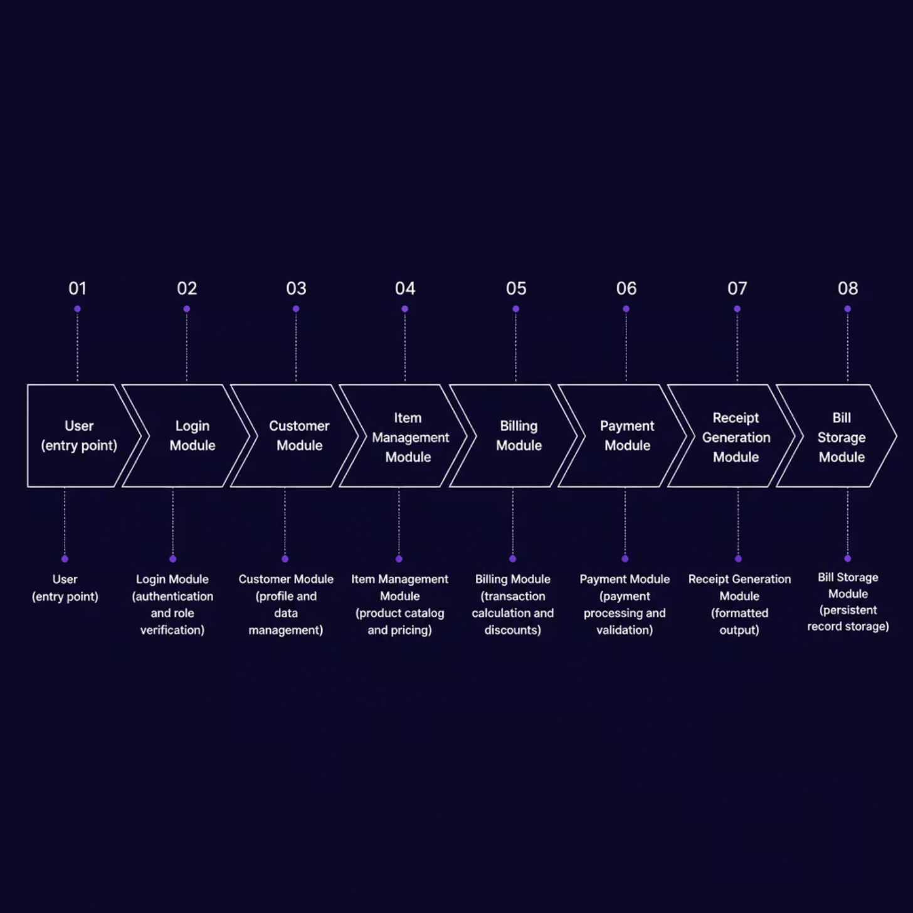
TECHNICAL DESIGN
System Architecture
Modular Architecture
The system follows a layered, modular architecture where each component has a single responsibility. Data flows sequentially from authentication through to persistent storage, ensuring separation of concerns and ease of maintenance.
Login Module — Role-based authentication
Billing Module — Core transaction logic
Payment Module — Multi-method processing
Storage Module — Persistent record keeping

Slide 8




OOP IMPLEMENTATION
Object-Oriented Programming Concepts
Class & Object
Encapsulation
Abstraction
The Item class encapsulates product attributes — name, price, quantity — instantiated as objects representing individual products in the catalog.
Data fields and methods are bundled within classes, exposing only necessary interfaces — protecting internal state and reducing unintended side effects.
Complex calculations for taxes, discounts, and totals are hidden behind clean method calls, simplifying usage and improving code readability.
These OOP principles collectively enhance software quality, maintainability, and extensibility — core goals of structured software engineering.

Slide 9
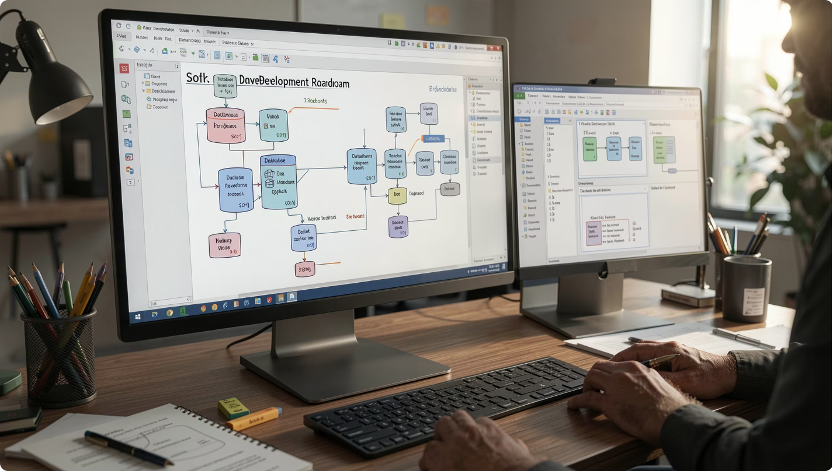
ROADMAP
Future Enhancements
GUI-Based Interface
Transition from console to a graphical user interface for improved usability.
Database Integration
Persistent data storage using SQL for customers, items, and transactions.
Inventory & Reporting
Real-time inventory tracking and a sales reporting dashboard for management.
Advanced OOP Features
Implement inheritance and polymorphism for extended class hierarchies.
Enhanced Security
Stronger authentication, input validation, and access control mechanisms.

Slide 10
SUMMARY
Conclusion
Project Achievement
OOP Benefits
Learning Outcomes
A fully functional, modular billing system was successfully designed and implemented using core OOP principles.
Encapsulation and abstraction produced clean, maintainable, and extensible code architecture.
Practical experience in software design, role-based systems, and structured programming methodology.
Thank You

